Slide 1
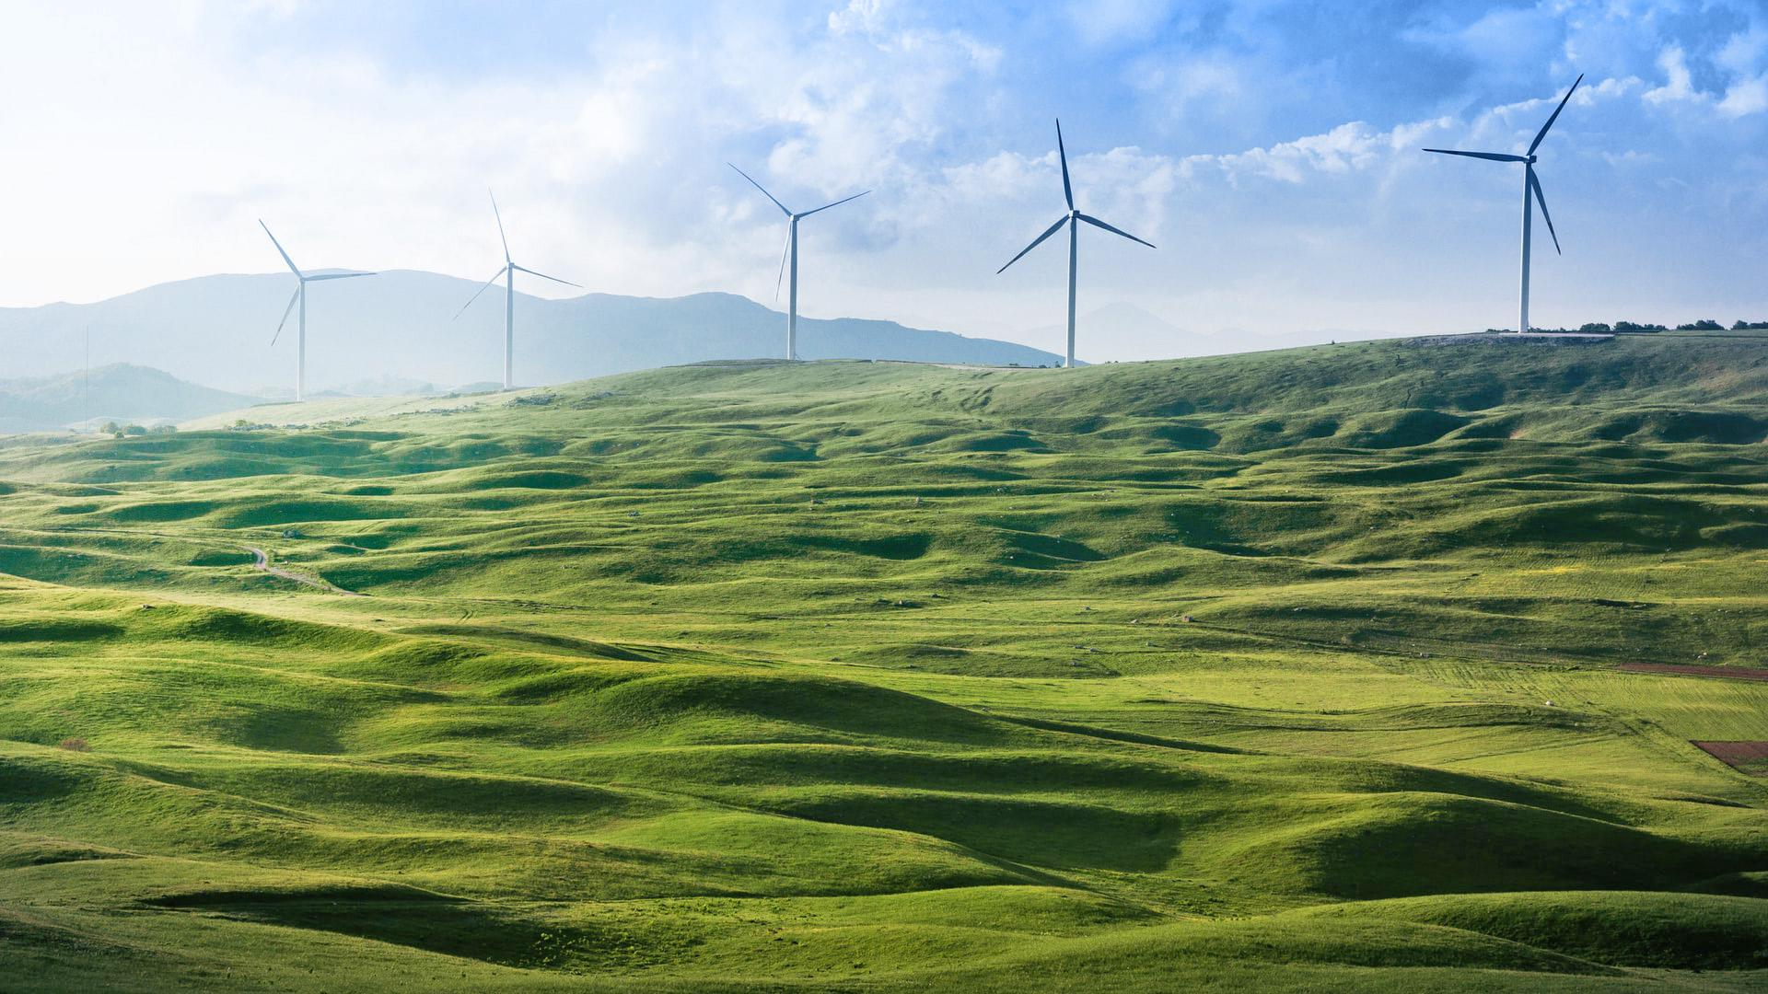
Electricity Consumption Predictor
THE HERTZ

Slide 2
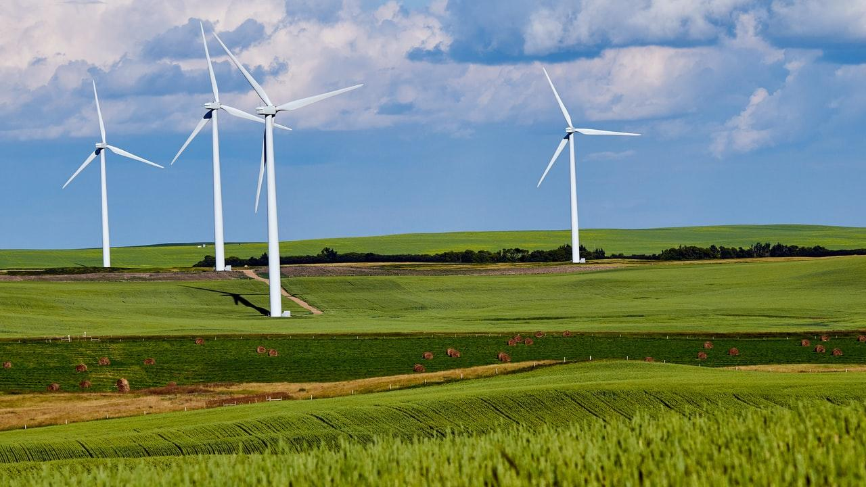
GROUP MEMBERS
Lean Nyaboke
(Power BI Specialist)
Melisa Michuki
(Business Researcher)
Paul Mwaura
(ML specialist)
Derrick Kuria
(Data Analyst)

Slide 3
Agenda
Problem Statement
Solution
Future plans
Data Exploration
Recommendation

Slide 4
Problem statement
Create a model that can learn the trend in consumption based on past electricity consumption data and different climatic information and predict electricity consumption on an hourly basis.

Slide 5
Region of focus
Countries in the Southern Hemisphere which experience winter From June to September

Slide 6
Business Importance & Impact
IMPORTANCE AND IMPACT OF THIS PROJECT
An accurate prediction allows the client to make better decisions in terms of cost and energy efficiency.
Helps avoid situations where demand exceeds available supply.
Pricing on the wholesale electricity market is organized in a way that sensitizes participants to plan their consumption and production precisely.

Slide 7
Research Questions
How does temperature affect electricity Consumption?
How does pressure affect electricity Consumption?
How does wind speed affect electricity Consumption?
How does var 1 affect electricity Consumption?
What is the trend and the stationarity in electricity consumption in between 2013 to 2017?

Slide 8
DATA EXPLORATION
UNIVARIATE ANALYSIS

Slide 9
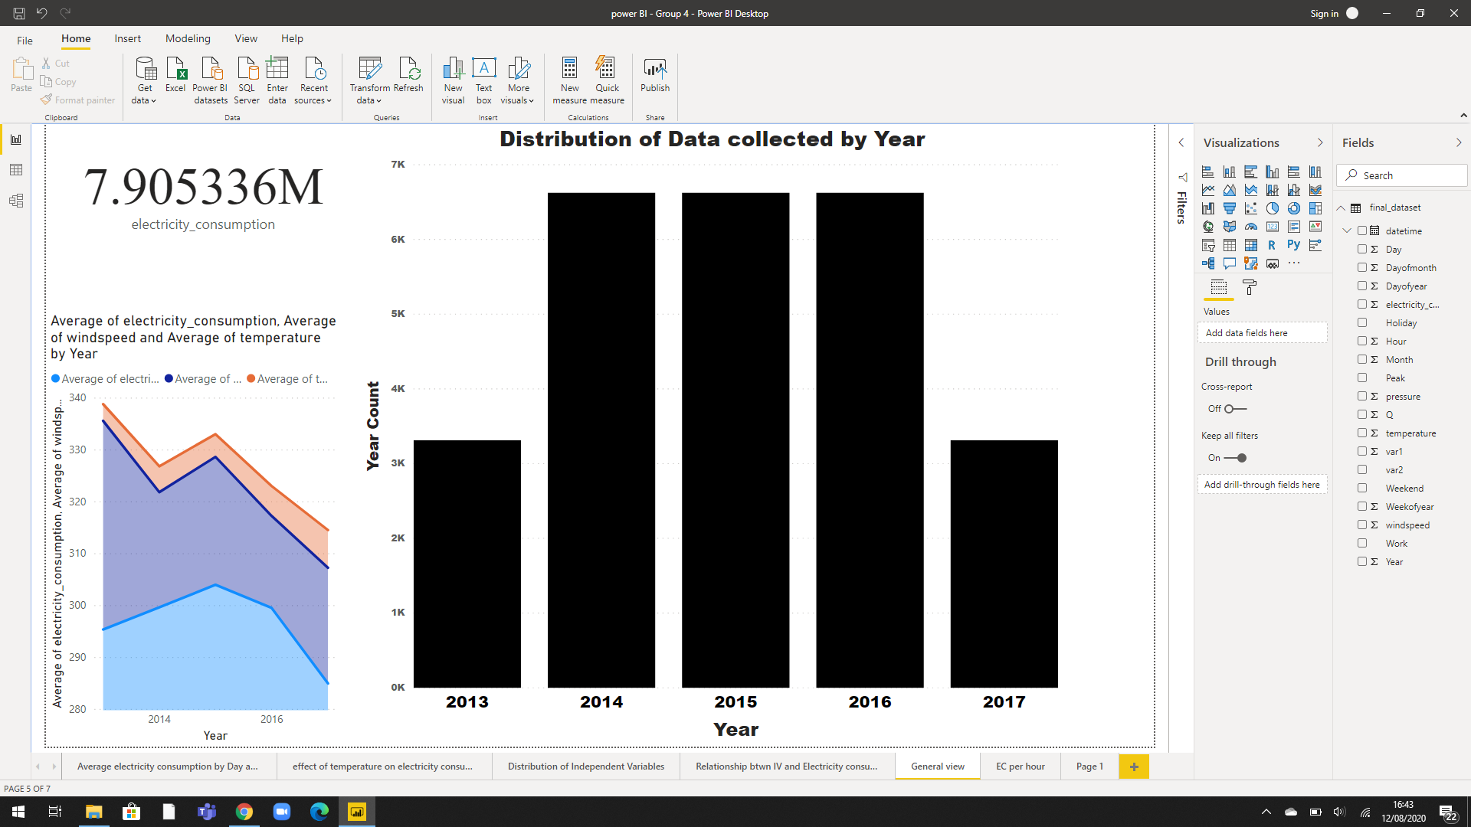
DISTRIBUTION OF DATA COLLECTED BY YEAR
The electricity Consumption data was collected from July 2013 to June 2017

Slide 10
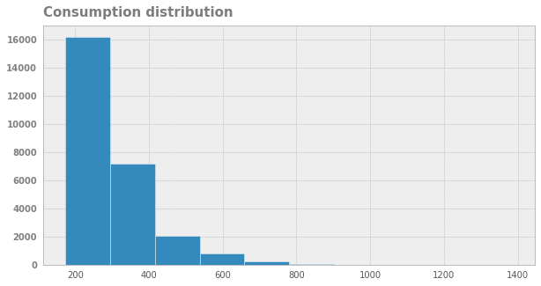
CONSUMPTION DISTRIBUTION OF ELECTRICITY
Most Customers use 400 Mwh and below.

Slide 11
DATA EXPLORATION
BIVARIATE ANALYSIS

Slide 12
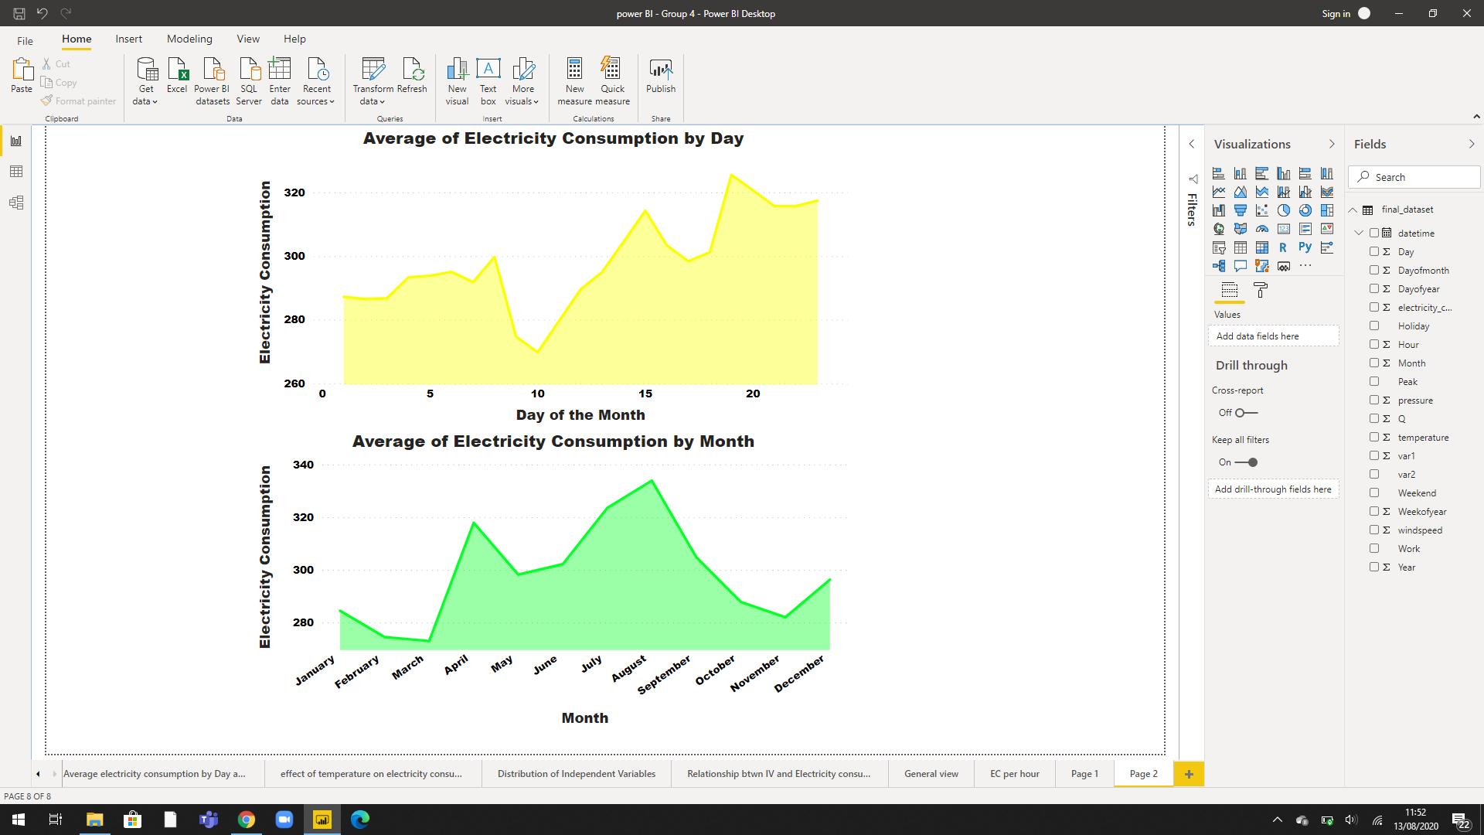
AVERAGE ELECTRICITY CONSUMPTION
From the analysis done, we found out the 19-20th day and August had the highest average electricity consumption.

Slide 13
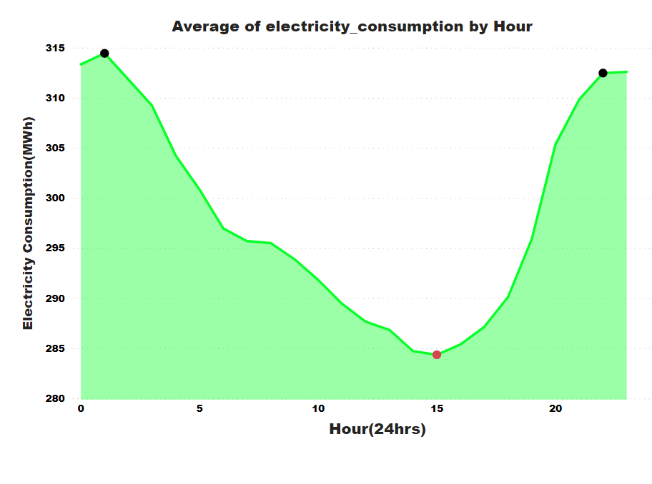
AVERAGE ELECTRICITY CONSUMPTION BY HOUR
At around 1500 Hrs everyday has the lowest average electricity consumption.

Slide 14
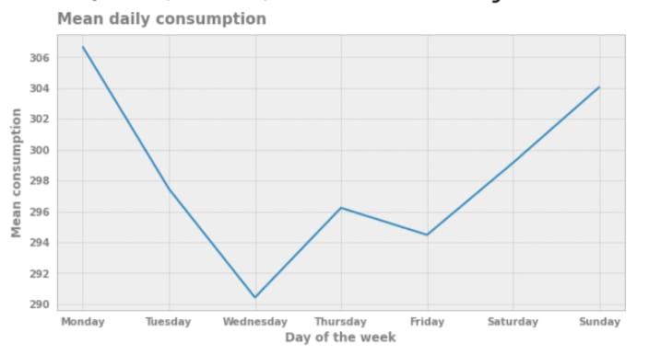
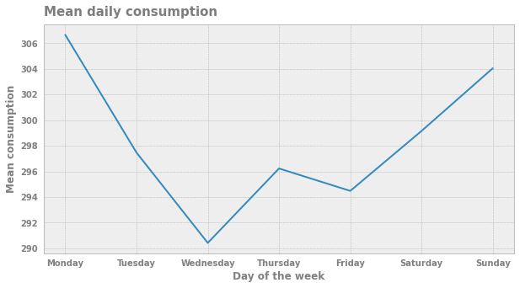
AVERAGE DISTRIBUTION OF ELECTRICITY BY DAY
Midweek days has the lowest and weekends have the highest electricity consumption by day.

Slide 15
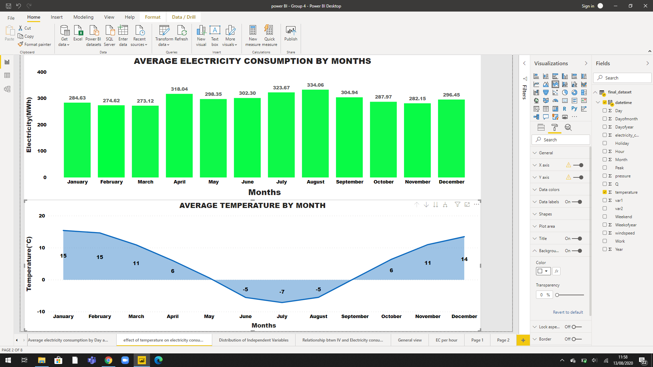
EFFECT OF TEMPERATURE ON ELECTRICITY CONSUMPTION
An increase in temperature would, in turn, lead to lower electricity consumption and a decrease in temperature leads to an increase in electricity consumption.
Notes:
An increase in pressure would, in turn, lead to higher electricity consumption and a decrease in pressure leads to an decrease in electricity consumption.
An increase in temperature would, in turn, lead to lower electricity consumption and a decrease in temperature leads to an increase in electricity consumption.

Slide 16
MODELLING
IMPLEMENTING THE SOLUTION

Slide 17
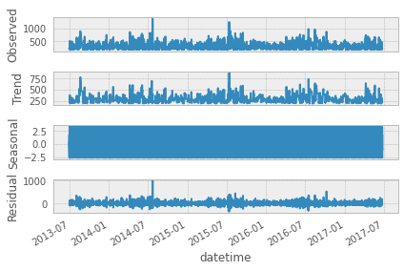
Check for Seasonality of the Energy Consumption variable
The trend in electricity consumption is almost stationary as it neither increases or decreases.

Slide 18
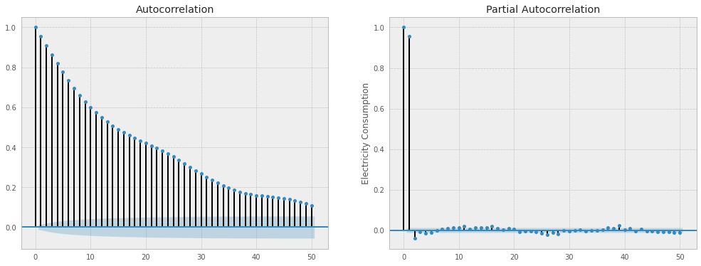
Autocorrelation and Partial Autocorrelation
After 40 lages, the line does not get inside the Confidence Interval meaning the data does not have seasonality.

Slide 19
Models
Three models have been implemented to predict electricity consumption.
SARIMA (Seasonal Autoregressive Integrated Moving Average)
It combines the ARIMA model with the ability to perform the same autoregression, differencing, and moving average modeling at the seasonal level.

Slide 20
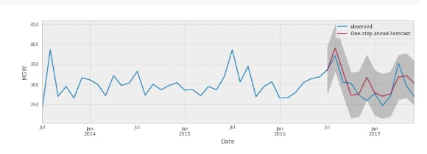
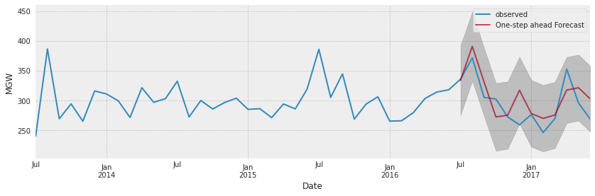
SARIMA MODEL
Predicting the Last year (July 2016 - July 2017) of the data for the Electricity consumption the observed data and the Forecast is close enough.

Slide 21
Models
XGBOOST
XGBoost is a decision-tree-based ensemble Machine Learning algorithm that uses a gradient boosting framework.
Date and Time | Actual | Predictions
0 | 2016-10-01 01:00:00 | 264.0 | 232.904205
1 | 2016-10-01 02:00:00 | 252.0 | 275.941956
2 | 2016-10-01 03:00:00 | 231.0 | 260.814941
3 | 2016-10-01 04:00:00 | 246.0 | 261.100494
4 | 2016-10-01 05:00:00 | 252.0 | 228.843979

Slide 22
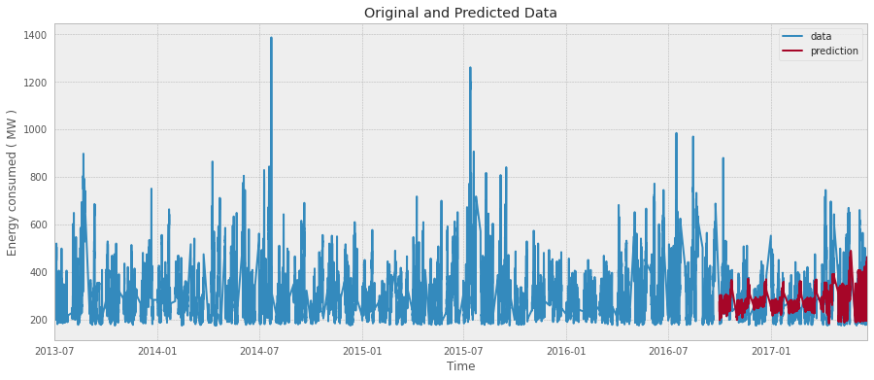
XGBOOST MODEL
The XGboost algorithm performs relatively well.
The accuracy is at 80.57%
The rmse is 82.44
Notes:
XGBOOST:
RMSE - 82.44355199009715
MAPE - 19.42774533269666%

Slide 23
Models
LSTM( Long short-term memory)
This is an artificial recurrent neural network (RNN) capable of learning order dependence in sequence prediction problems.
Date and Time | Actual | Predicted
0 | 2017-10-01 01:00:00 | 213.0 | 234.655685
1 | 2017-10-01 02:00:00 | 216.0 | 234.704346
2 | 2017-10-01 03:00:00 | 213.0 | 234.645737
3 | 2017-10-01 04:00:00 | 204.0 | 234.633652
4 | 2017-10-01 05:00:00 | 228.0 | 234.647186

Slide 24
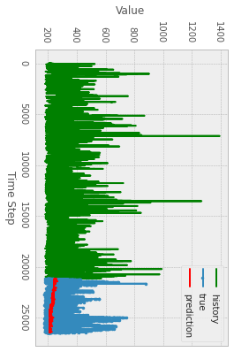
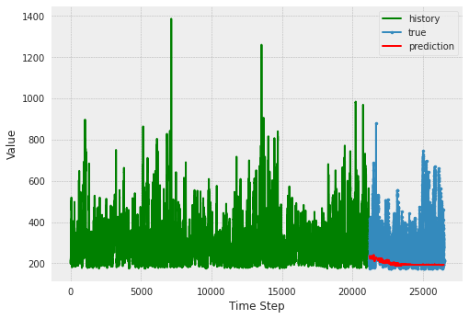
LSTM MODEL
The LSTM algorithm performed relatively well.
The accuracy is at 74.62%.
The rmse 126.69
Notes:
Our primary model is XGBOOST it has lower percentage value of errors and also a lower RMSE.
LSTM:
RMSE - 126.68996156020141
MAPE - 25.38466705115224%

Slide 25

CONCLUSION
RECOMMENDATIONS

Slide 26
Our recommendations
Advise the company when to subsidize and to add the cost of electricity bills using the peak and off peak months for profitability.
Incase of energy inadequacies , the company knows the best time for power rationing during the day which is between 11 AM - 6 PM when the electricity is relatively consumed low.
The company now comprehends the average consumption and can allocate resources to areas that may have low consumption may be due to high costs.

Slide 27

CONCLUSION
FUTURE PLANS

Slide 28
Our future plans
Implementing the project for a lighting company.
Find a dataset that looks into other aspects that affect electricity consumption other than environmental factors eg government regulations and global markets.

Slide 29
Electricity can transform people's lives, not just economically but also socially.
Piyush Goyal

Slide 30

QUESTIONS
QUESTIONS

Slide 31
Use diagrams to explain your ideas
01
Vestibulum nec congue tempus
Vestibulum nec congue tempus
Vestibulum nec congue tempus
03
02
Vestibulum nec congue tempus

Slide 32
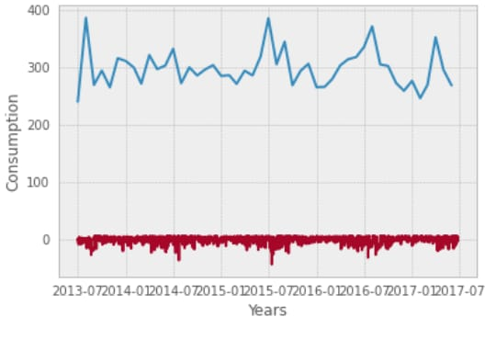
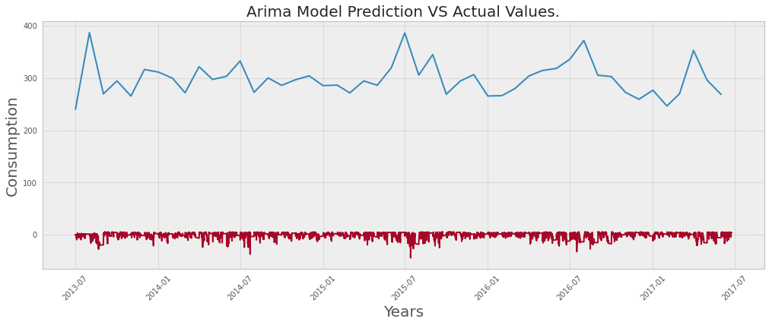
ARIMA MODEL
The ARIMA model did not perform well . As seen in the graph its predicted trend was far from the actual data.
Notes:
The ARIMA model did not perform well . As seen in the graph its predicted trend was far from the actual data.

Slide 33
And tables to compare data
 | A | B | C
Yellow | 10 | 20 | 7
Blue | 30 | 15 | 10
Orange | 5 | 24 | 16

Slide 34
insights

Slide 35
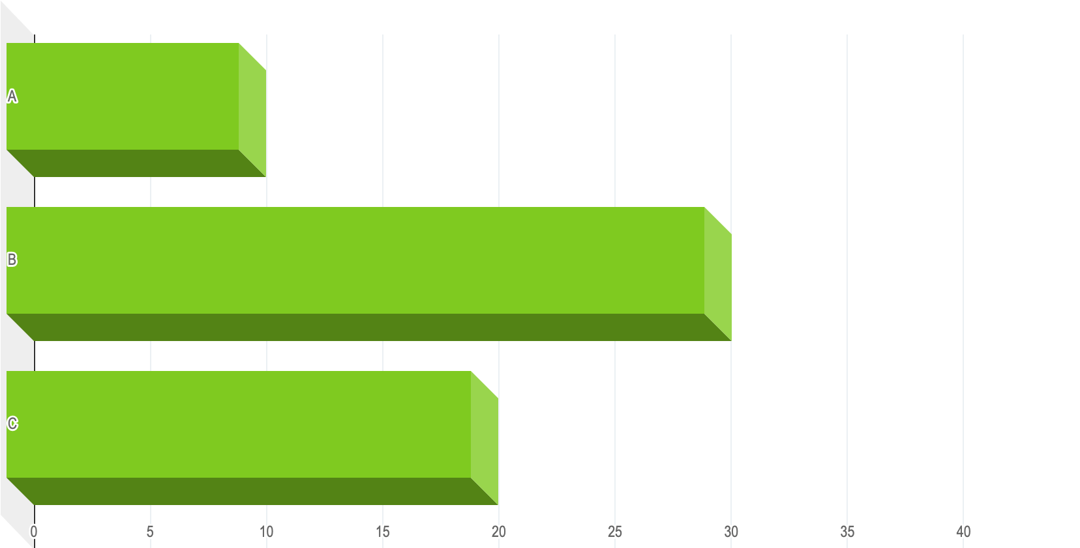
You can insert graphs from Excel or Google Sheets

Slide 36
Presentation design
This presentation uses the following typographies:
Titles: Merriweather
Body copy: IBM Plex Sans
Download for free at:
https://www.fontsquirrel.com/fonts/merriweather
https://www.fontsquirrel.com/fonts/ibm-plex
You don’t need to keep this slide in your presentation. It’s only here to serve you as a design guide if you need to create new slides or download the fonts to edit the presentation in PowerPoint®

Slide 37
SlidesCarnival icons are editable shapes. This means that you can:
Resize them without losing quality.
Change fill color and opacity.
Change line color, width and style.
Isn’t that nice? :) Examples:
Find more icons at slidescarnival.com/extra-free-resources-icons-and-maps

Slide 38
Diagrams and infographics

Slide 39
😉
You can also use any emoji as an icon! And of course it resizes without losing quality.
How? Follow Google instructions https://twitter.com/googledocs/status/730087240156643328
✋👆👉👍👤👦👧👨👩👪💃🏃💑❤😂😉😋😒😭👶😸🐟🍒🍔💣📌📖🔨🎃🎈🎨🏈🏰🌏🔌🔑 and many more...

